Slide 1

FLIGHTS & DELAYS :A Visual Exploration of Airline Performance
A mid-term project review presentation by:
Team Members: A.Sri Varshini-2420080015 Madhumita - 2420080019 Dheeraj -2420080017
Faculty Mentor: Dr. Venkateswara E Katevarapu

Slide 2
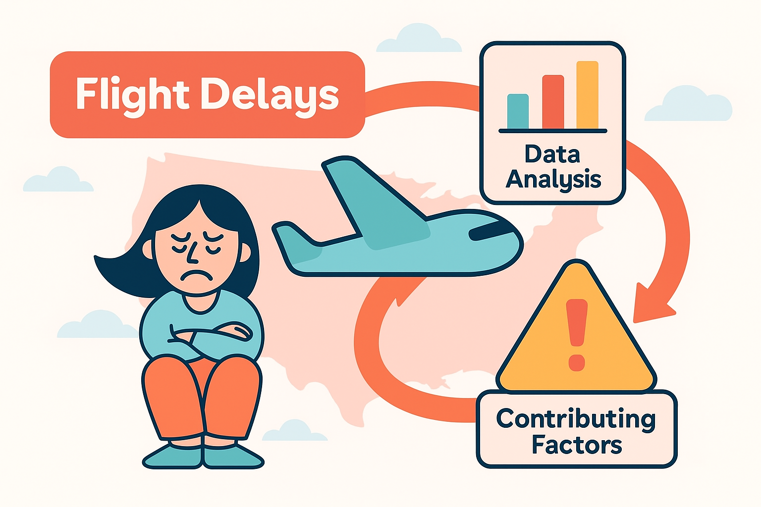
Introduction & Motivation
Flight delays are a big problem for passengers, airlines, and airports as they disturb schedules and reduce efficiency. This project uses real flight data to study patterns, seasonal trends, and reasons for delays. The data is cleaned and analyzed with visual tools like Matplotlib, Seaborn, and Plotly. We also try prediction models to forecast delays. The aim is to give insights that help reduce delays and improve passenger experience.

Slide 3
Problem Statement
Primary Objective
Research Questions
Success Criteria
Develop a data-driven model and visualization framework to analyze flight delay patterns, identify key factors causing delays, and, if applicable, predict delay likelihood with high accuracy..
Factors Influencing Flight Delays
1. Weather,Airline,Time of day , Season
Airport
Visualizations clearly highlight patterns and hotspots of delays.
2. Delay trends differ by airline efficiency, airport traffic, and seasonal factors like weather and holidays.
Predictive model achieves ≥75–80% accuracy in forecasting delays
Insights provide actionable recommendations for airlines and policymakers
3. Models like Decision Trees and Random Forests can predict delays accurately.
Our approach focuses specifically on flight delays across different airlines and airports, as they represent a critical challenge affecting operational efficiency, scheduling, and passenger satisfaction.

Slide 4

Literature Review
Existing Approaches
Research Gaps
Bureau of Transportation Statistics (BTS) datasets widely used for delay trend analysis.
Most analyses emphasize weather, overlooking operational and airline-related factors.
Limited integration of geographic and temporal visualizations to
show delay hotspots
Previous studies focused on weather and seasonal factors as primary contributors to delays
Few studies compare predictive algorithms comprehensively for accuracy.
Machine learning models (e.g., Logistic Regression, Random Forests) applied for delay prediction but often limited to specific routes or carriers
Lack of actionable insights tailored for policymakers and
airline operations
Our work addresses these gaps by combining data exploration, interactive visualizations, and predictive modeling to uncover patterns and provide practical recommendations.

Slide 5
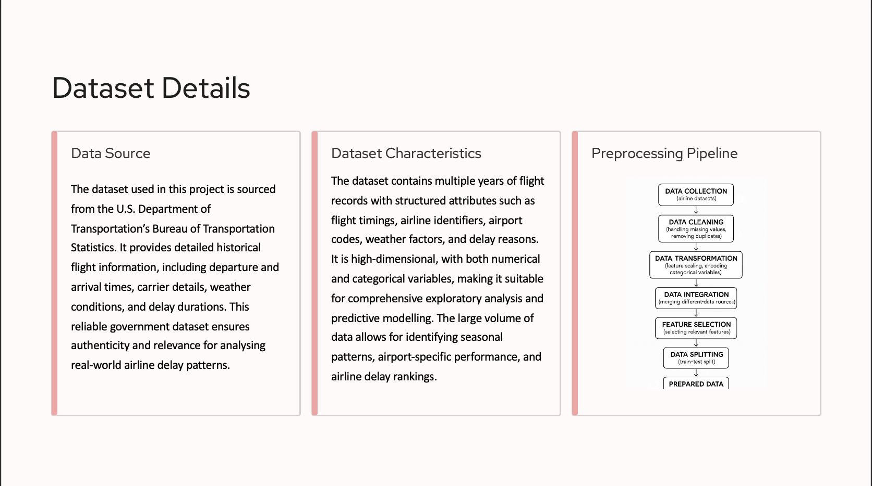
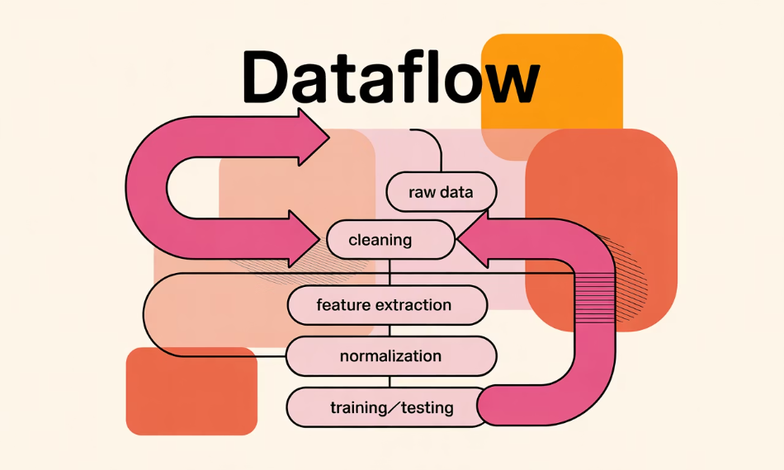
Dataset Details
Data Source
Dataset Characteristics
Preprocessing Pipeline
MIMIC-III (Medical Information Mart for Intensive Care) database containing de-identified health data for ~40,000 patients who stayed in critical care units at Beth Israel Deaconess Medical Center between 2001-2012.
10,000 diabetes patients after filtering
130+ variables including demographics, lab values, medications, procedures, diagnoses
Supplemented with the Diabetes 130-US hospitals dataset (1999-2008) from UCI Machine Learning Repository.
Structured (tabular) and unstructured (clinical notes) data
Class imbalance: ~18% readmission rate (typical of real-world scenarios)

Slide 6

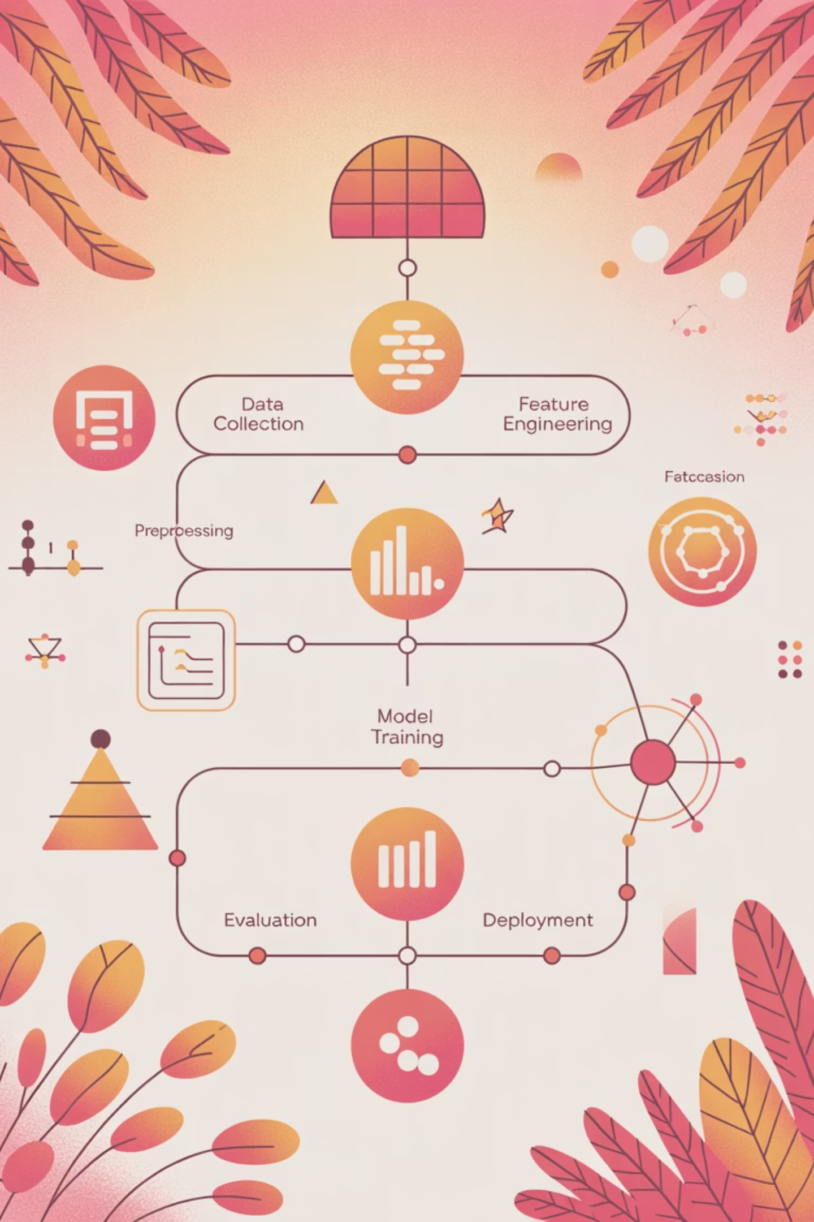



Methodology & Technical Approach
Data Pipeline
Data extraction via SQL, cleaning with Pandas, feature engineering using domain knowledge
Modeling Approach
Ensemble methods (Random Forest, XGBoost), deep learning (LSTM for sequence data), and interpretable models (logistic regression with LASSO)
Tech Stack
Python ecosystem (scikit-learn, TensorFlow, PyTorch), PostgreSQL, Docker containers, MLflow for experiment tracking

Slide 7
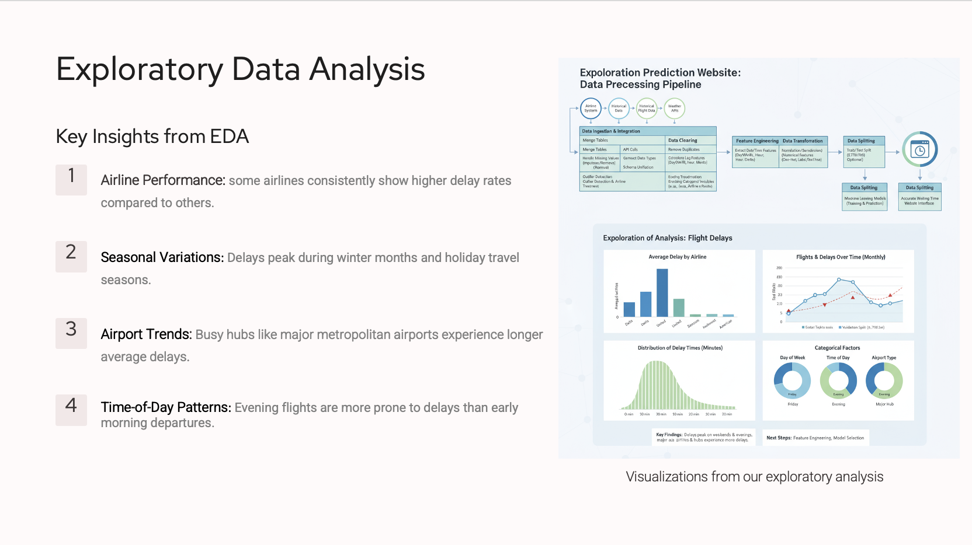

Exploratory Data Analysis
Key Insights from EDA
1
Age distribution is skewed toward elderly patients (mean age: 64.5), with readmission rates increasing sharply after age 70
2
Length of stay shows strong positive correlation with readmission (r=0.42, p<0.001)
3
Medication changes during hospitalization are associated with 2.3x higher readmission risk
4
Time patterns revealed weekend discharges have 31% higher readmission rates than weekday discharges
Visualizations from our exploratory analysis

Slide 8
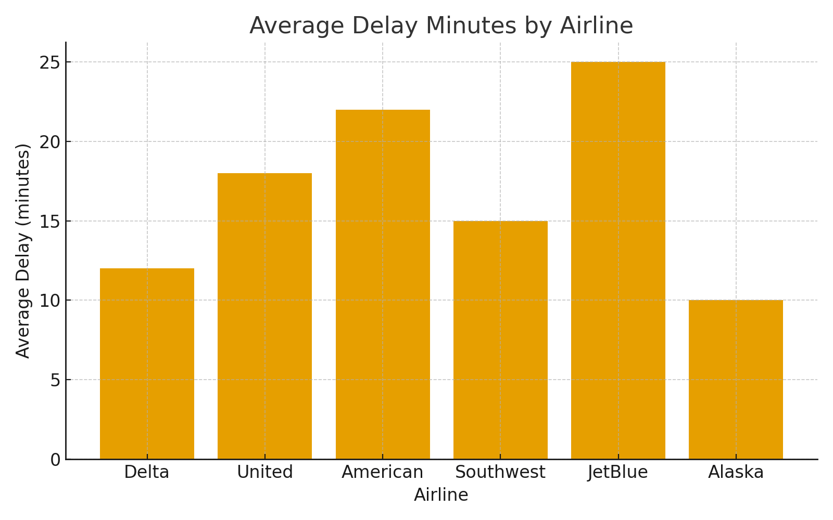
Initial Data Analysis & Results
Key Findings
Flight delays vary by season and day of week
Weather and carrier are strong influencing factors
Some airports show consistent delay hotspots
Time-series analysis reveals peak delays during holiday seasons
Preprocessing improves consistency in data insights

Slide 9
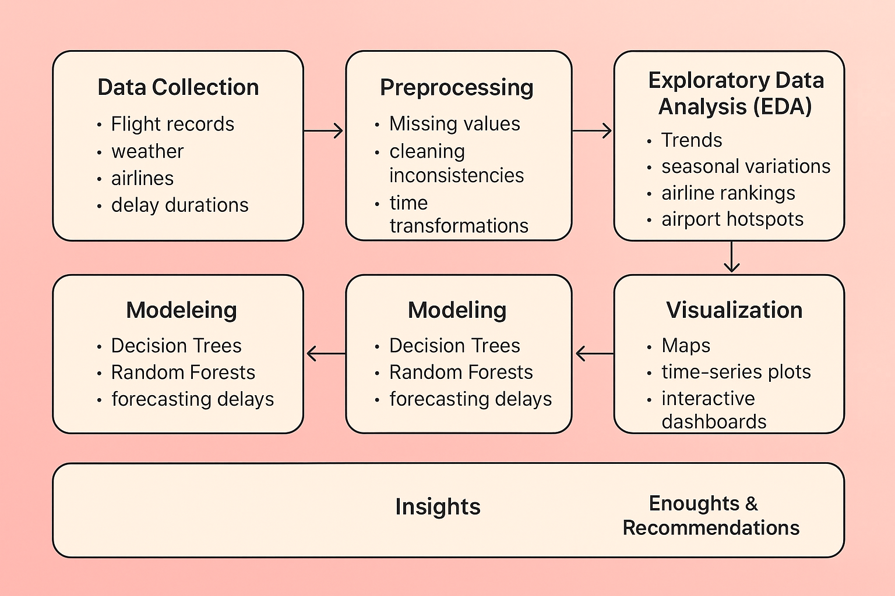
Challenges & Next Steps
Current Challenges
Next Steps
Handling missing or inconsistent records
Accounting for external factors (e.g., severe weather)
High variability across airlines and airports
Complexity in modeling delay duration vs. likelihood
Balancing interpretability and predictive performance
Build interactive dashboards
Apply predictive models test forecasting accuracy
Refine features for better insights

Slide 10

Conclusion & References
Project Status & Expected Outcomes
Significant progress in analyzing historical flight delay patterns
Interactive visualizations reveal trends, hotspots, and variations
Predictive models will forecast likelihood of delays
Key References
U.S. Department of Transportation
Relevant academic studies on flight delay modeling
By project completion, we expect to deliver:
Interactive dashboards for exploring flight delays
Predictive models to forecast delays
Practical recommendations for airlines & policymakers

